Slide 1
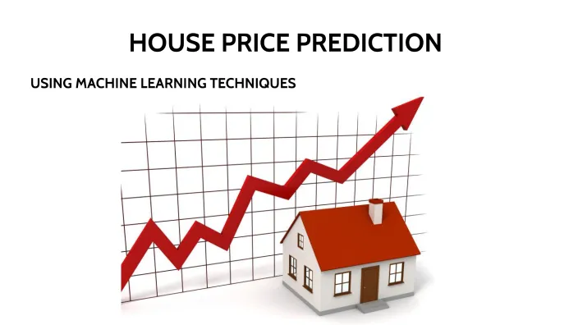
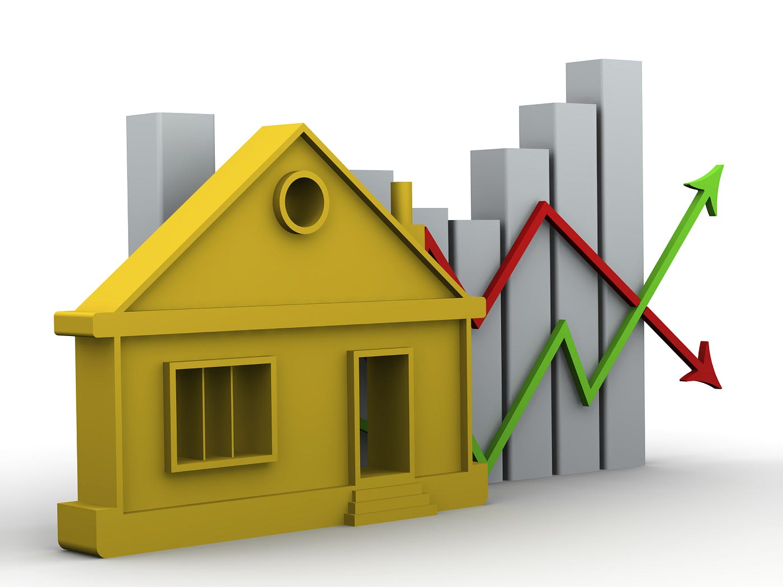
Predicting House Prices with Machine Learning
TEAM MEMBERS
DIVYANSHU MISHRA
YASH PARCHA
SAGAR
DEVANSH GARG

Slide 2

Introduction to python
Python is a general-purpose, dynamically typed, high-level, compiled and interpreted, garbage-collected, and purely object-oriented programming language that supports procedural, object-oriented, and functional programming.
It was Created by Guido van Rossum and first released in 1991, Python emphasizes code readability and allows programmers to express concepts in fewer lines of code compared to languages like C++ or Java.

Slide 3

Introduction to Machine Learning
Machine learning (ML) is a subfield of artificial intelligence (AI) that involves the development of algorithms and statistical models enabling computers to perform tasks without explicit instructions. Instead, these systems learn patterns and make decisions based on data. Machine learning is transforming various industries by automating complex processes, providing insights from large datasets, and creating new opportunities for innovation.

Slide 4
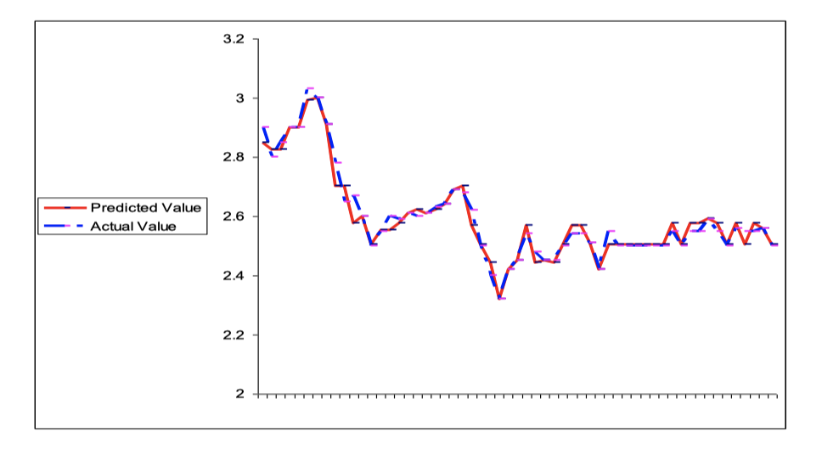
How it works?
COLLECTING DATA : First step is to collect data from different sources & merge them together to form our dataset.
MACHINE LEARNING : Then we train the data using machine learning algorithm.
GRAPH : Create graphs on the basis on analyzing dataset using machine learning.
PREDICTION : Based on the generated data we predict the future prices of houses.

Slide 5

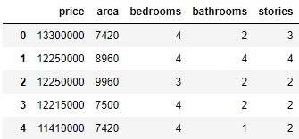
IMPORTING DATA USING MACHINE LANGUAGE
IMPORTING LIABRARIES
DATA READ: pd. read_csv(' Housing.csv') is a function in Pandas that reads a comma-separated values (CSV) file into a Data Frame df.

Slide 6
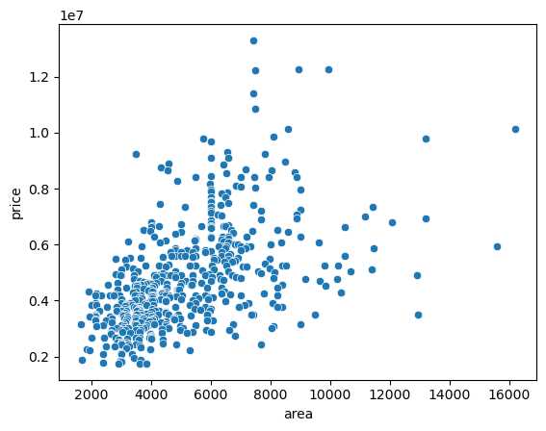
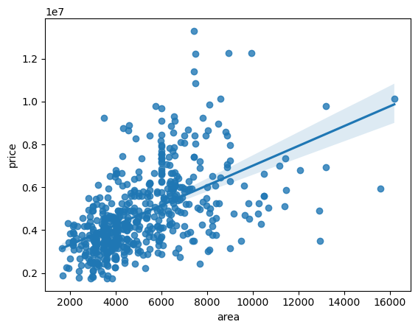
DATA Evaluation with Graphs
Actual vs. Predicted Prices Scatter Plot
Description: This plot shows the relationship between the actual house prices and the predicted prices from your model.
Purpose: Helps in visualizing how close the predictions are to the actual values.
Interpretation: Points close to the diagonal line (where Actual = Predicted) indicate high accuracy.

Slide 7
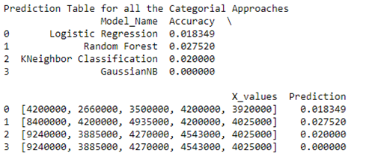
DATA COMPARISON WITH DATA ACCURACIES
LOGISTIC REGRESSION
RANDOM FOREST
K-NEIGHBOR CLASSIFICATION
GAUSSIAN-NB

Slide 8
CONCLUSION
So we conclude that with this system, we can predict the house prices in the future on the basis of dataset graphs and model evaluation. Which help us to find the good accuracy of the prices with the help of machine learning. These predictions can help the customers and sellers.

Slide 9
THANK YOU

